Slide 1

Bastian Jaeger
Tilburg University
Social Psychology
Study 1
p = .042
p = .039
How to evaluate
the credibility of
published research findings

Slide 2
Behavioral sciences in crisis
Large, collaborative projects show that effects do not replicate
36% (35/97) effects replicated Open Science Collaboration, 2015
62% (13/21) effects in Nature & Science replicated Camerer et al., 2018a
Experimental economics: 61% (11/18) replicated Camerer et al., 2018b
Many findings in the literature do not seem to describe true phenomena

Slide 3

The p < .05 criterion
p value: the probability of obtaining the observed difference (or a more extreme one) if the null hypothesis is true
p-hacking: exploiting flexibilities in the research cycle to achieve significant results Simmons et al., 2011
p < .05

Slide 4
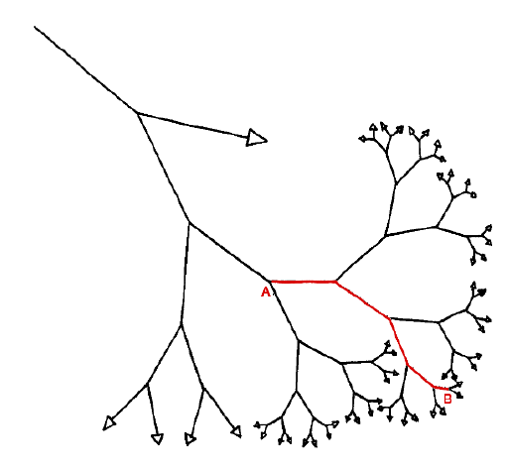
p-hacking
Flexibility in reporting
Flexibility in sample size
Flexibility in inclusion of covariates
Flexibility in analyses
….
Simmons, Nelson, & Simonsohn (2011)

Slide 5
p-hacking
Recruited 34 participants, but some were excluded
Chronological rejuvenation study
20 university students
Listen to ‘When I’m Sixty-Four’ or ‘Kalimba’
Indicated their birthday and their father’s age (which was included to control for baseline age differences)
‘people were nearly a year-and-a-half younger after listening to “When I’m Sixty-Four” (adjusted M = 20.1 years) rather than to “Kalimba” (adjusted M = 21.5 years), F(1, 17) = 4.92, p = .040.’
A third condition was dropped
11 more variables (such as mother’s age) were also measured
Not significant without the covariate
Simmons, Nelson, & Simonsohn (2011)

Slide 6
Remedies
1) Pre-register!
2) Quantify the credibility of published results
Excess significance
p value distribution

Slide 7



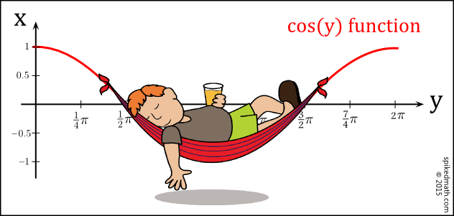
Disclaimers

Slide 8

Excess significance
Power: the probability of finding a significant result given that the alternative hypothesis is true
Independent-samples t-test, d = 0.3, alpha = 5%, power = 80%
Required sample = 352
Independent-samples t-test, d = 0.5, alpha = 5%, sample size = 60
Power = 48%
http://www.gpower.hhu.de/

Slide 9
Excess significance
80%
% of significant results:
When testing true hypothesis 100% of the time
With alpha = 5%
And power = 80%
42.5%
% of significant results:
When testing true hypotheses 50% of the time
With alpha = 5%
And power = 80%
Typical power in psychology: ~50% Fraley & Vazire, 2014
Percentage of tests that are significant: ~93.5% Sterling, 1995

Slide 10
Excess significance
Example 1: only significant results
7 statistical tests, all significant
100 participants, d = 0.5
1) Calculate power:
70%
2) Calculate likelihood of finding 7 significant findings:
0.7 x 0.7 x 0.7 x 0.7 x 0.7 x 0.7 x 0.7 = 0.082
8.2% chance of finding only significant effects across 7 studies with 70% power

Slide 11
Excess significance
Example 2: some non-significant results (Bem, 2011)
10 statistical tests, 9 significant
n = 120, d = 0.22
Incredibility index: probability of obtaining more non-significant results than were reported given the tests’ power Schimmack, 2012
http://shinyapps.org/apps/p-checker/
9/10 significant tests
75% power
76% chance of finding more than 1 non-significant results for 10 tests

Slide 12
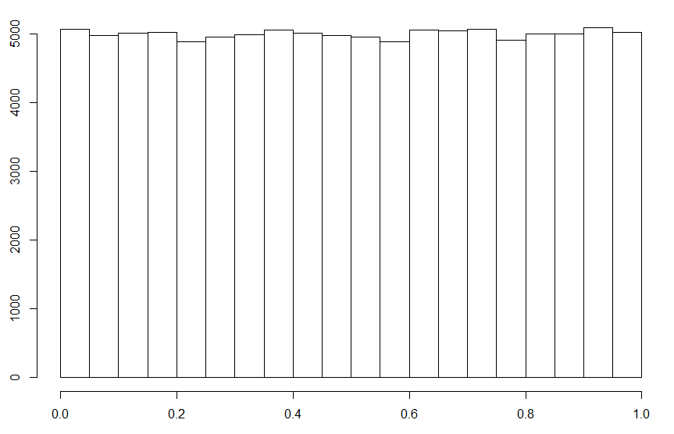
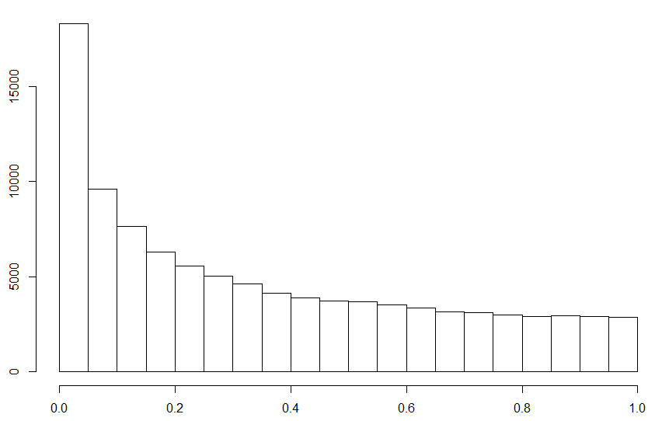
Distribution of p-values
d = 0
d = 0.15

Slide 13
Distribution of p-values
How often should we observe large, but significant p values (.01 - .05)?
http://rpsychologist.com/d3/pdist/
d = 0.5
n = 100
barely significant results: 8.5%

Slide 14

Distribution of p-values
Higher fWHR for:
DOWJones CEOS vs. controls p = .014
DAX CEOs vs. controls p = .094
NGO CEOS: vs. controls p = .006
Popes vs. controls p = .023
Correlations:
DOWJones CEO fWHR employee satisfaction p = .015
DOWJones CEO fWHR CEO approval p = .042
DOWJones CEO fWHR charitable donations p = .033
DOWJones CEO fWHR sustainability index p = .064

Slide 15
Distribution of p-values
8 findings with p values between .006 and .094
~d = 0.8
~n = 30
Likelihood of 1 p value in observed range: 28.57%
Likelihood of 8 p values in observed range: 0.054%
0.054% chance of observing this set of p values given the effect is true

Slide 16
Distribution of p-values
p-curve: analyzes the shape of the distribution of significant p values to determine if a set of findings contains evidential value Simonsohn et al., 2012
http://shinyapps.org/apps/p-checker/

Slide 17
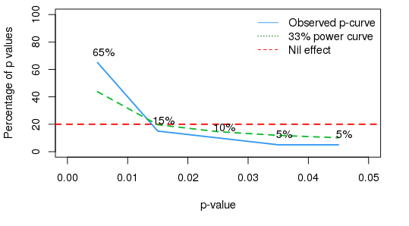
Hypothetical
Studies contain evidential value: p < .001
Studies’ evidential value is inadequate: p = .90
Studies lack evidential value and were intensely p-hacked: p = .83

Slide 18
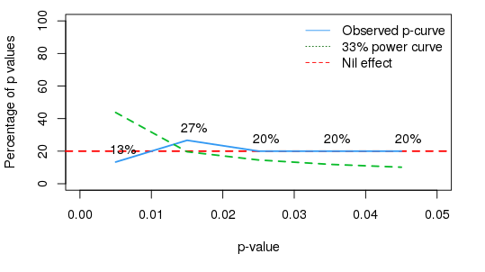
fWHR paper
Studies contain evidential value: p = .41
Studies’ evidential value is inadequate: p = .024
Studies lack evidential value and were intensely p-hacked: p = .59

Slide 19
Conclusion
Compare observed statistics against expected statistics given the properties of the statistical test
Limitations
Multiple statistics needed
Probabilistic estimates
Actual power of a test unknown
Flexibilities in selection of p values

Slide 20
Suggested readings
Ioannidis, J. P. A. (2005). Why most published research findings are false. PLoS Medicine, 2(8), 0696–0701. https://doi.org/10.1371/journal.pmed.0020124
Simmons, J. P., Nelson, L. D., & Simonsohn, U. (2011). False-positive psychology: Undisclosed flexibility in data collection and analysis allows presenting anything as significant. Psychological Science, 22(11), 1359–1366. https://doi.org/10.1177/0956797611417632
Schimmack, U. (2012). The ironic effect of significant results on the credibility of multiple-study articles. Psychological Methods, 17(4), 551–566. https://doi.org/10.1037/a0029487
Simonsohn, U., Nelson, L. D., & Simmons, J. P. (2014). P-curve: A key to the file-drawer. Journal of Experimental Psychology: General, 143(2), 534–547. https://doi.org/10.1037/a0033242

Slide 21

Thanks for listening!
b.jaeger@uvt.nl

